Slide 1
Asset Status
Asset Import
Asset Audit
Asset History
Asset Reports
eassets
Deploy Asset
Deploy your asset with QR Code
Track & Audit Asset
Get Asset data with just Scan
Reporting
Get asset report in just single click

Slide 2






What you can do with eAssets
Add everyone to the system
Everyone in your organization can get access to the same software and can see asset details.
Built-in barcode scanner
No more need for expensive and bulky barcode scanning equipment that’s incompatible with other devices.
View asset history
Enhanced accountability and forecasting for every asset with full audit trails.
Full Audit Dashboard
See what audits are in progress, complete, and coming up for your teams. Generate new audits and
get deeper detail with ease from both desktop and mobile devices.
Audit Assets
Yearly audit made easy, Say no to excel spreadsheet to audit assets. Save time to locate asset.
Enable role-based access
Get enhanced data security and simple onboarding for every job function in your organization.

Slide 3
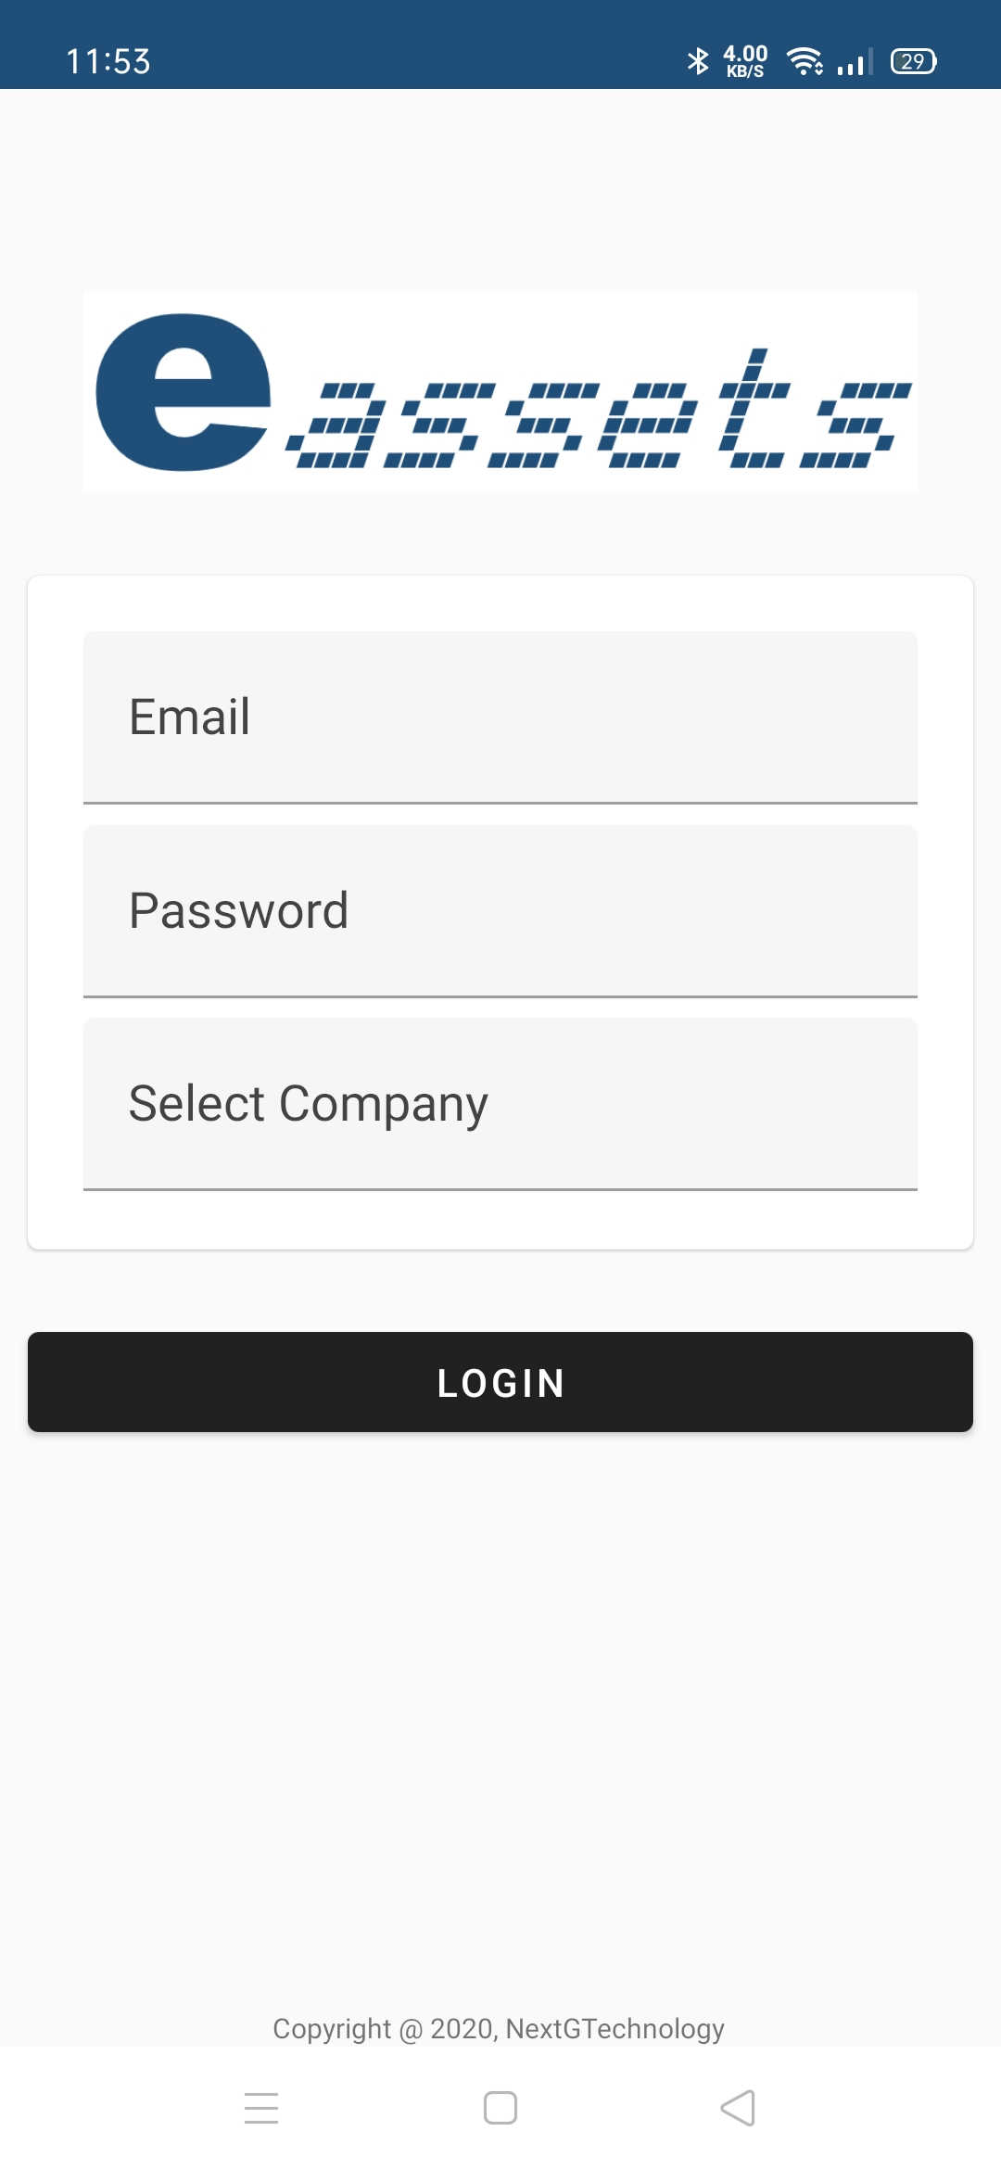
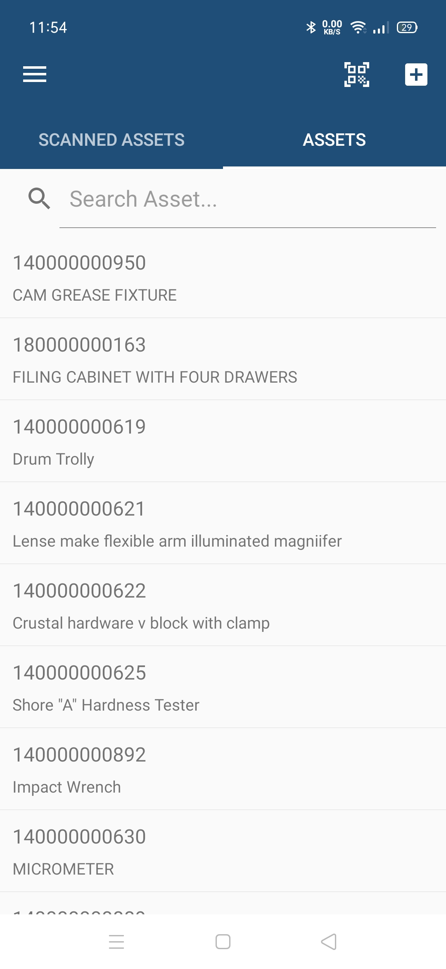
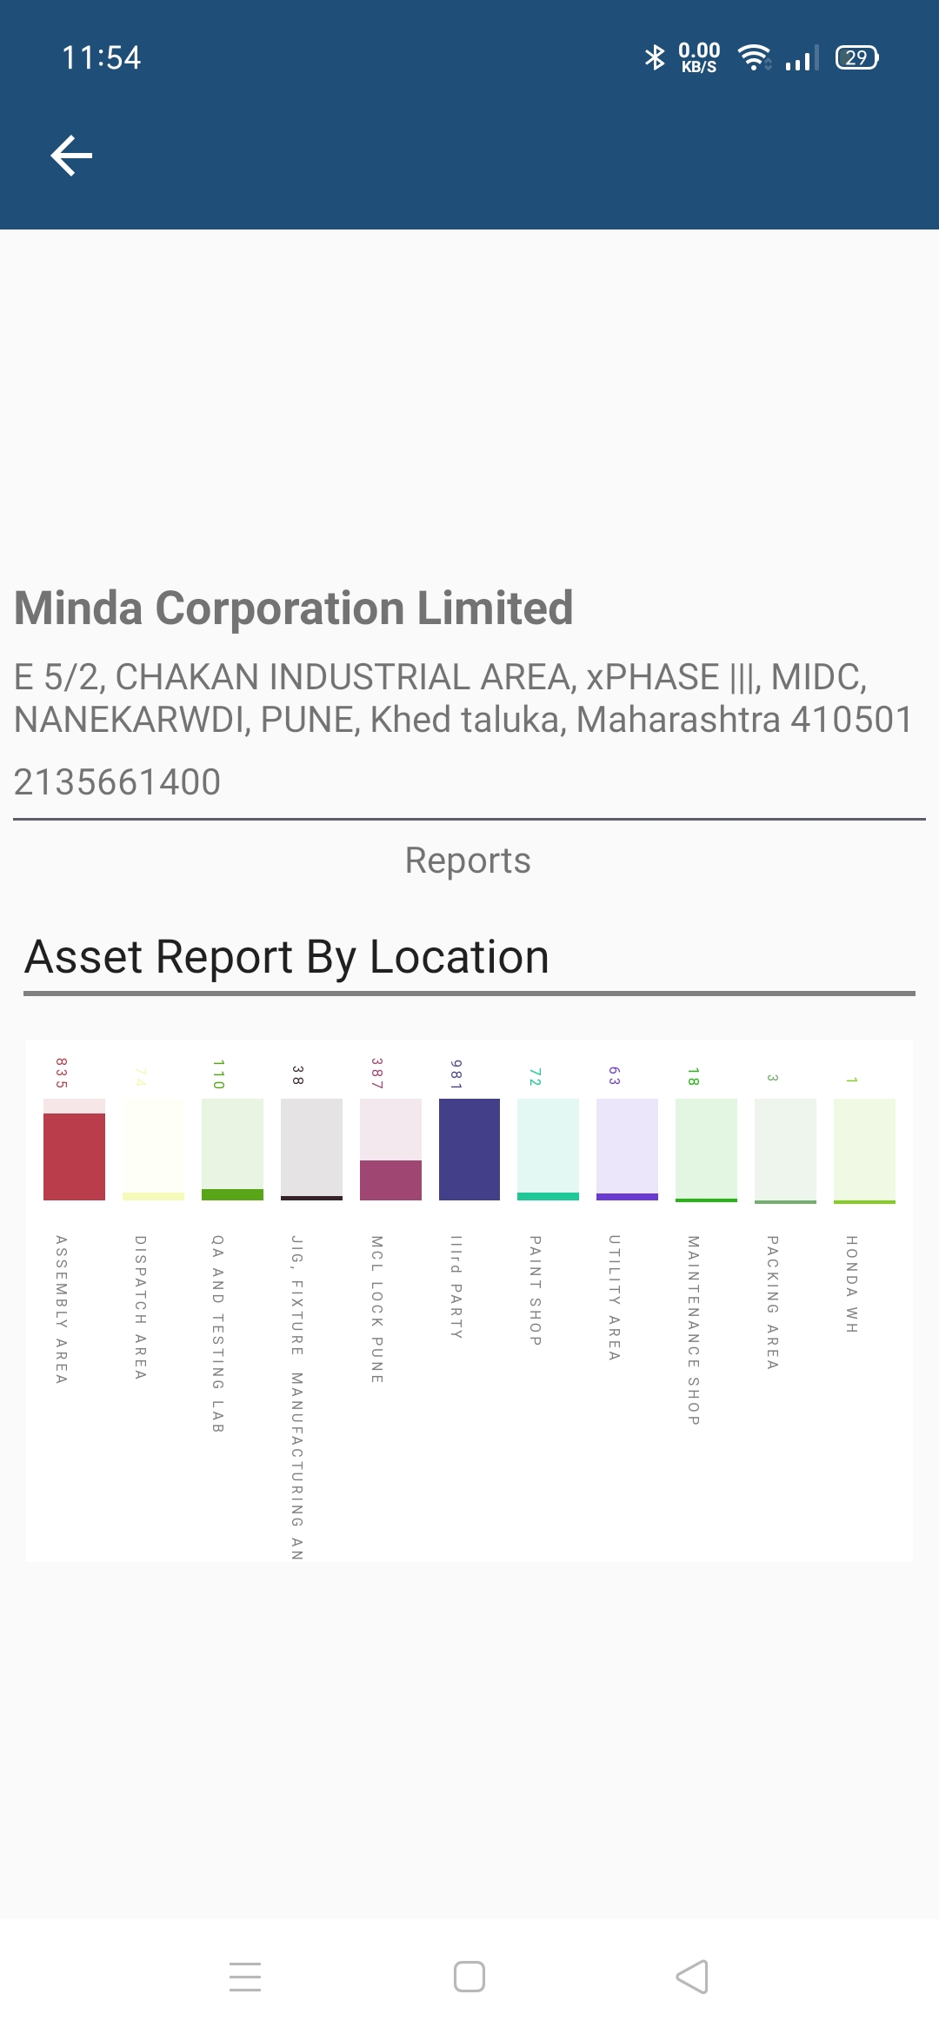
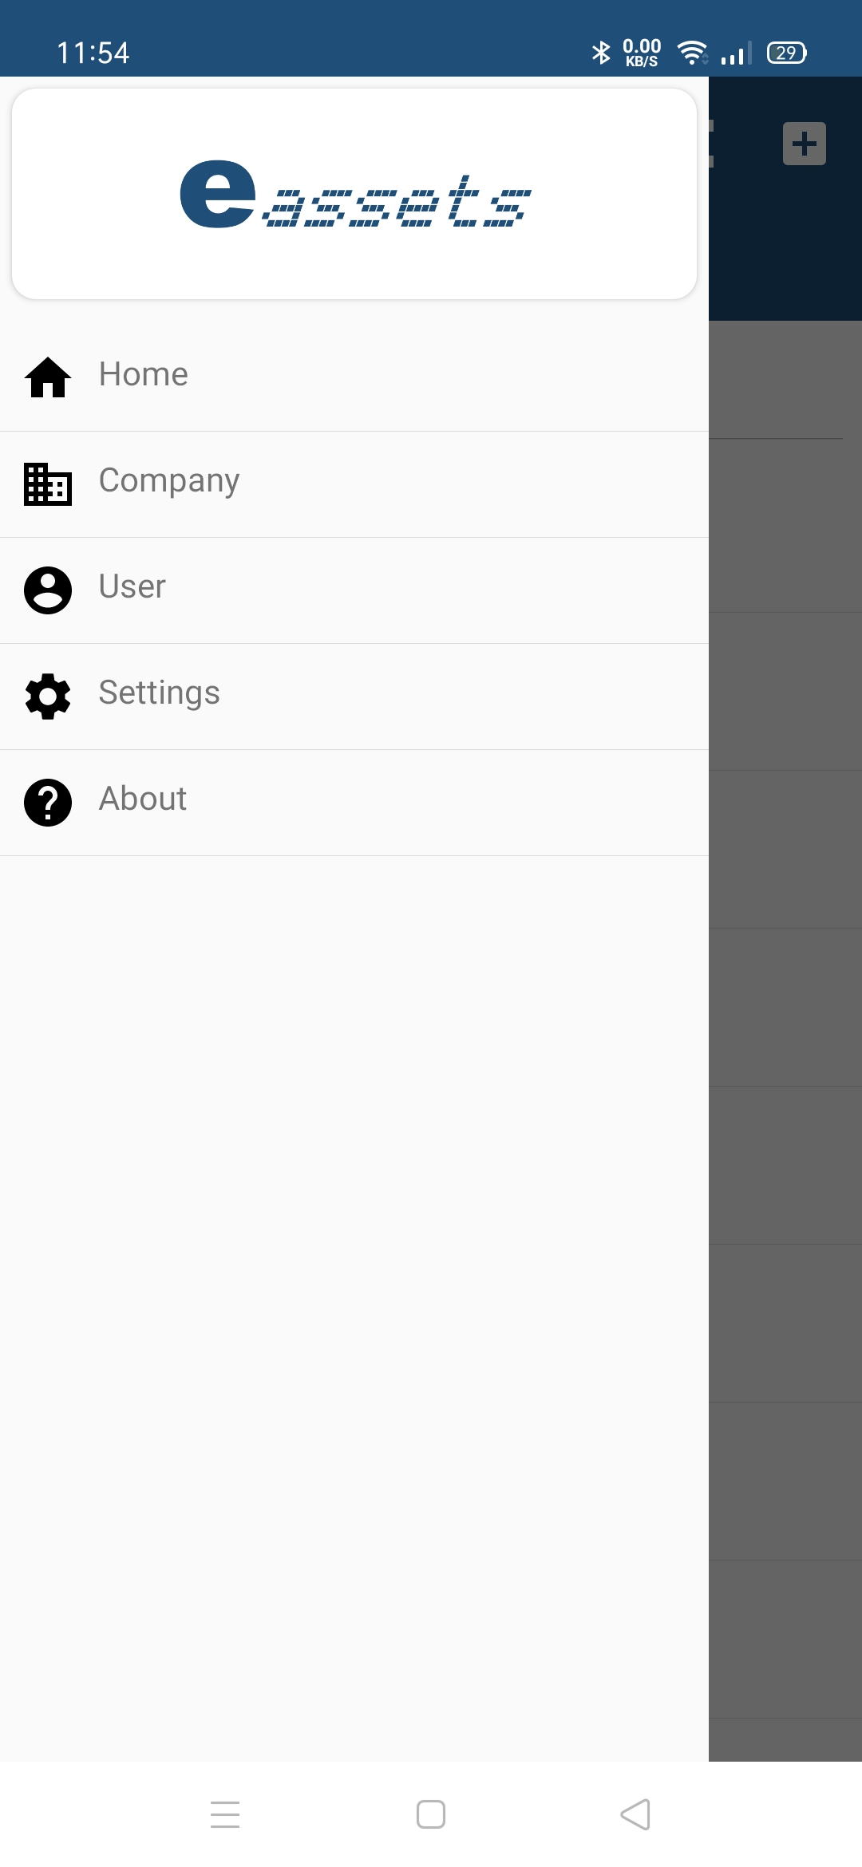
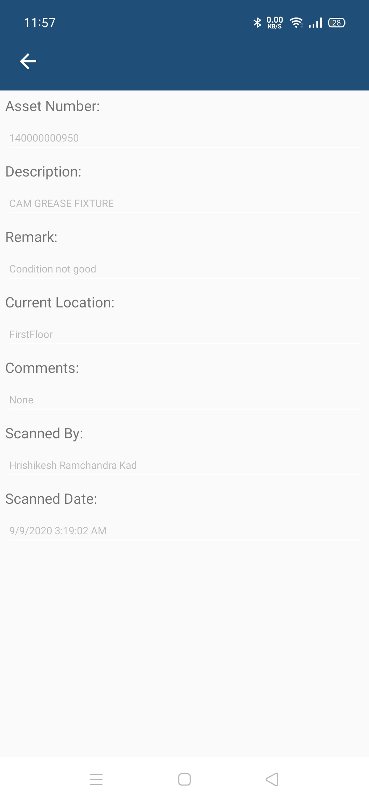
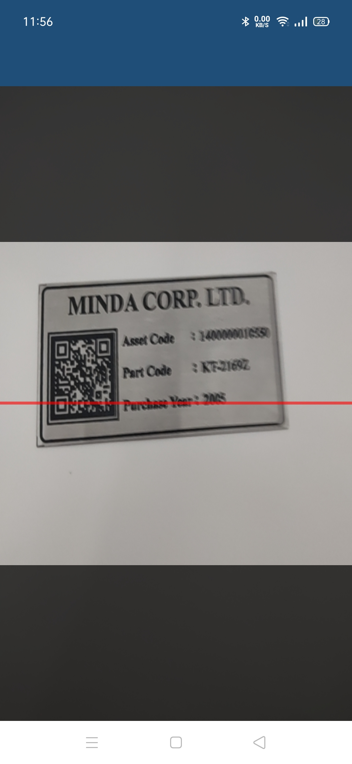
Mobile Application

Slide 4
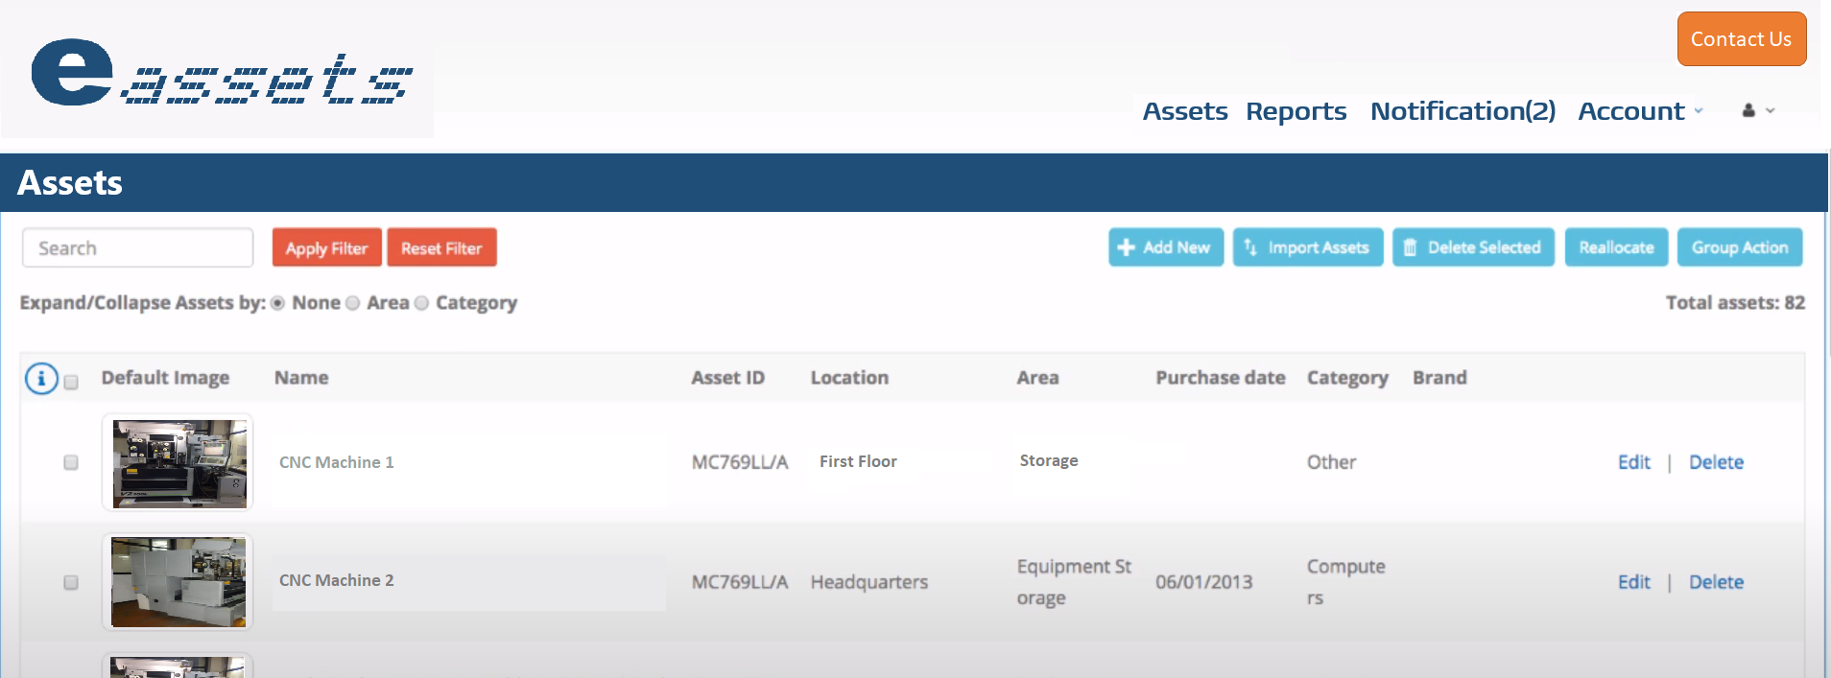
Web Application

Slide 5


Our AIM
Complete Solution
Complete solution for Assets Management And Asset Audit
Asset lifecycle management
Procurement => Deploy => Maintain => Support => Dispose
Live Asset Tracking
Track current location and person holding the assets
GPS tracking of assets
Tracking of movable assets with GPS tracker

Slide 6
Contact us
Hrishikesh.kad@gmail.com
+919096115848

Slide 7
Thank You !

